Slide 1
VERTICAL SEGMENTATION

Slide 2
C = ∏D
C = Circumference
∏ = 3.14159…
D = Diameter

Slide 3
Length of X = C/(# of pieces)
X
A
A = 180° / (# of pieces)

Slide 4
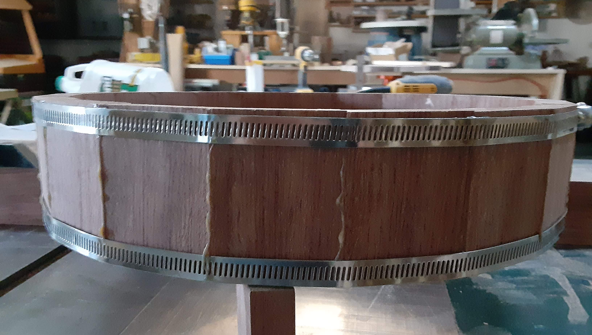

Slide 5
BAND CLAMPS
Amazon – Cambridge Quick Release Clamps
From 7” to 63” in length
½ in wide Stainless Steel
10 to a pack

Slide 6
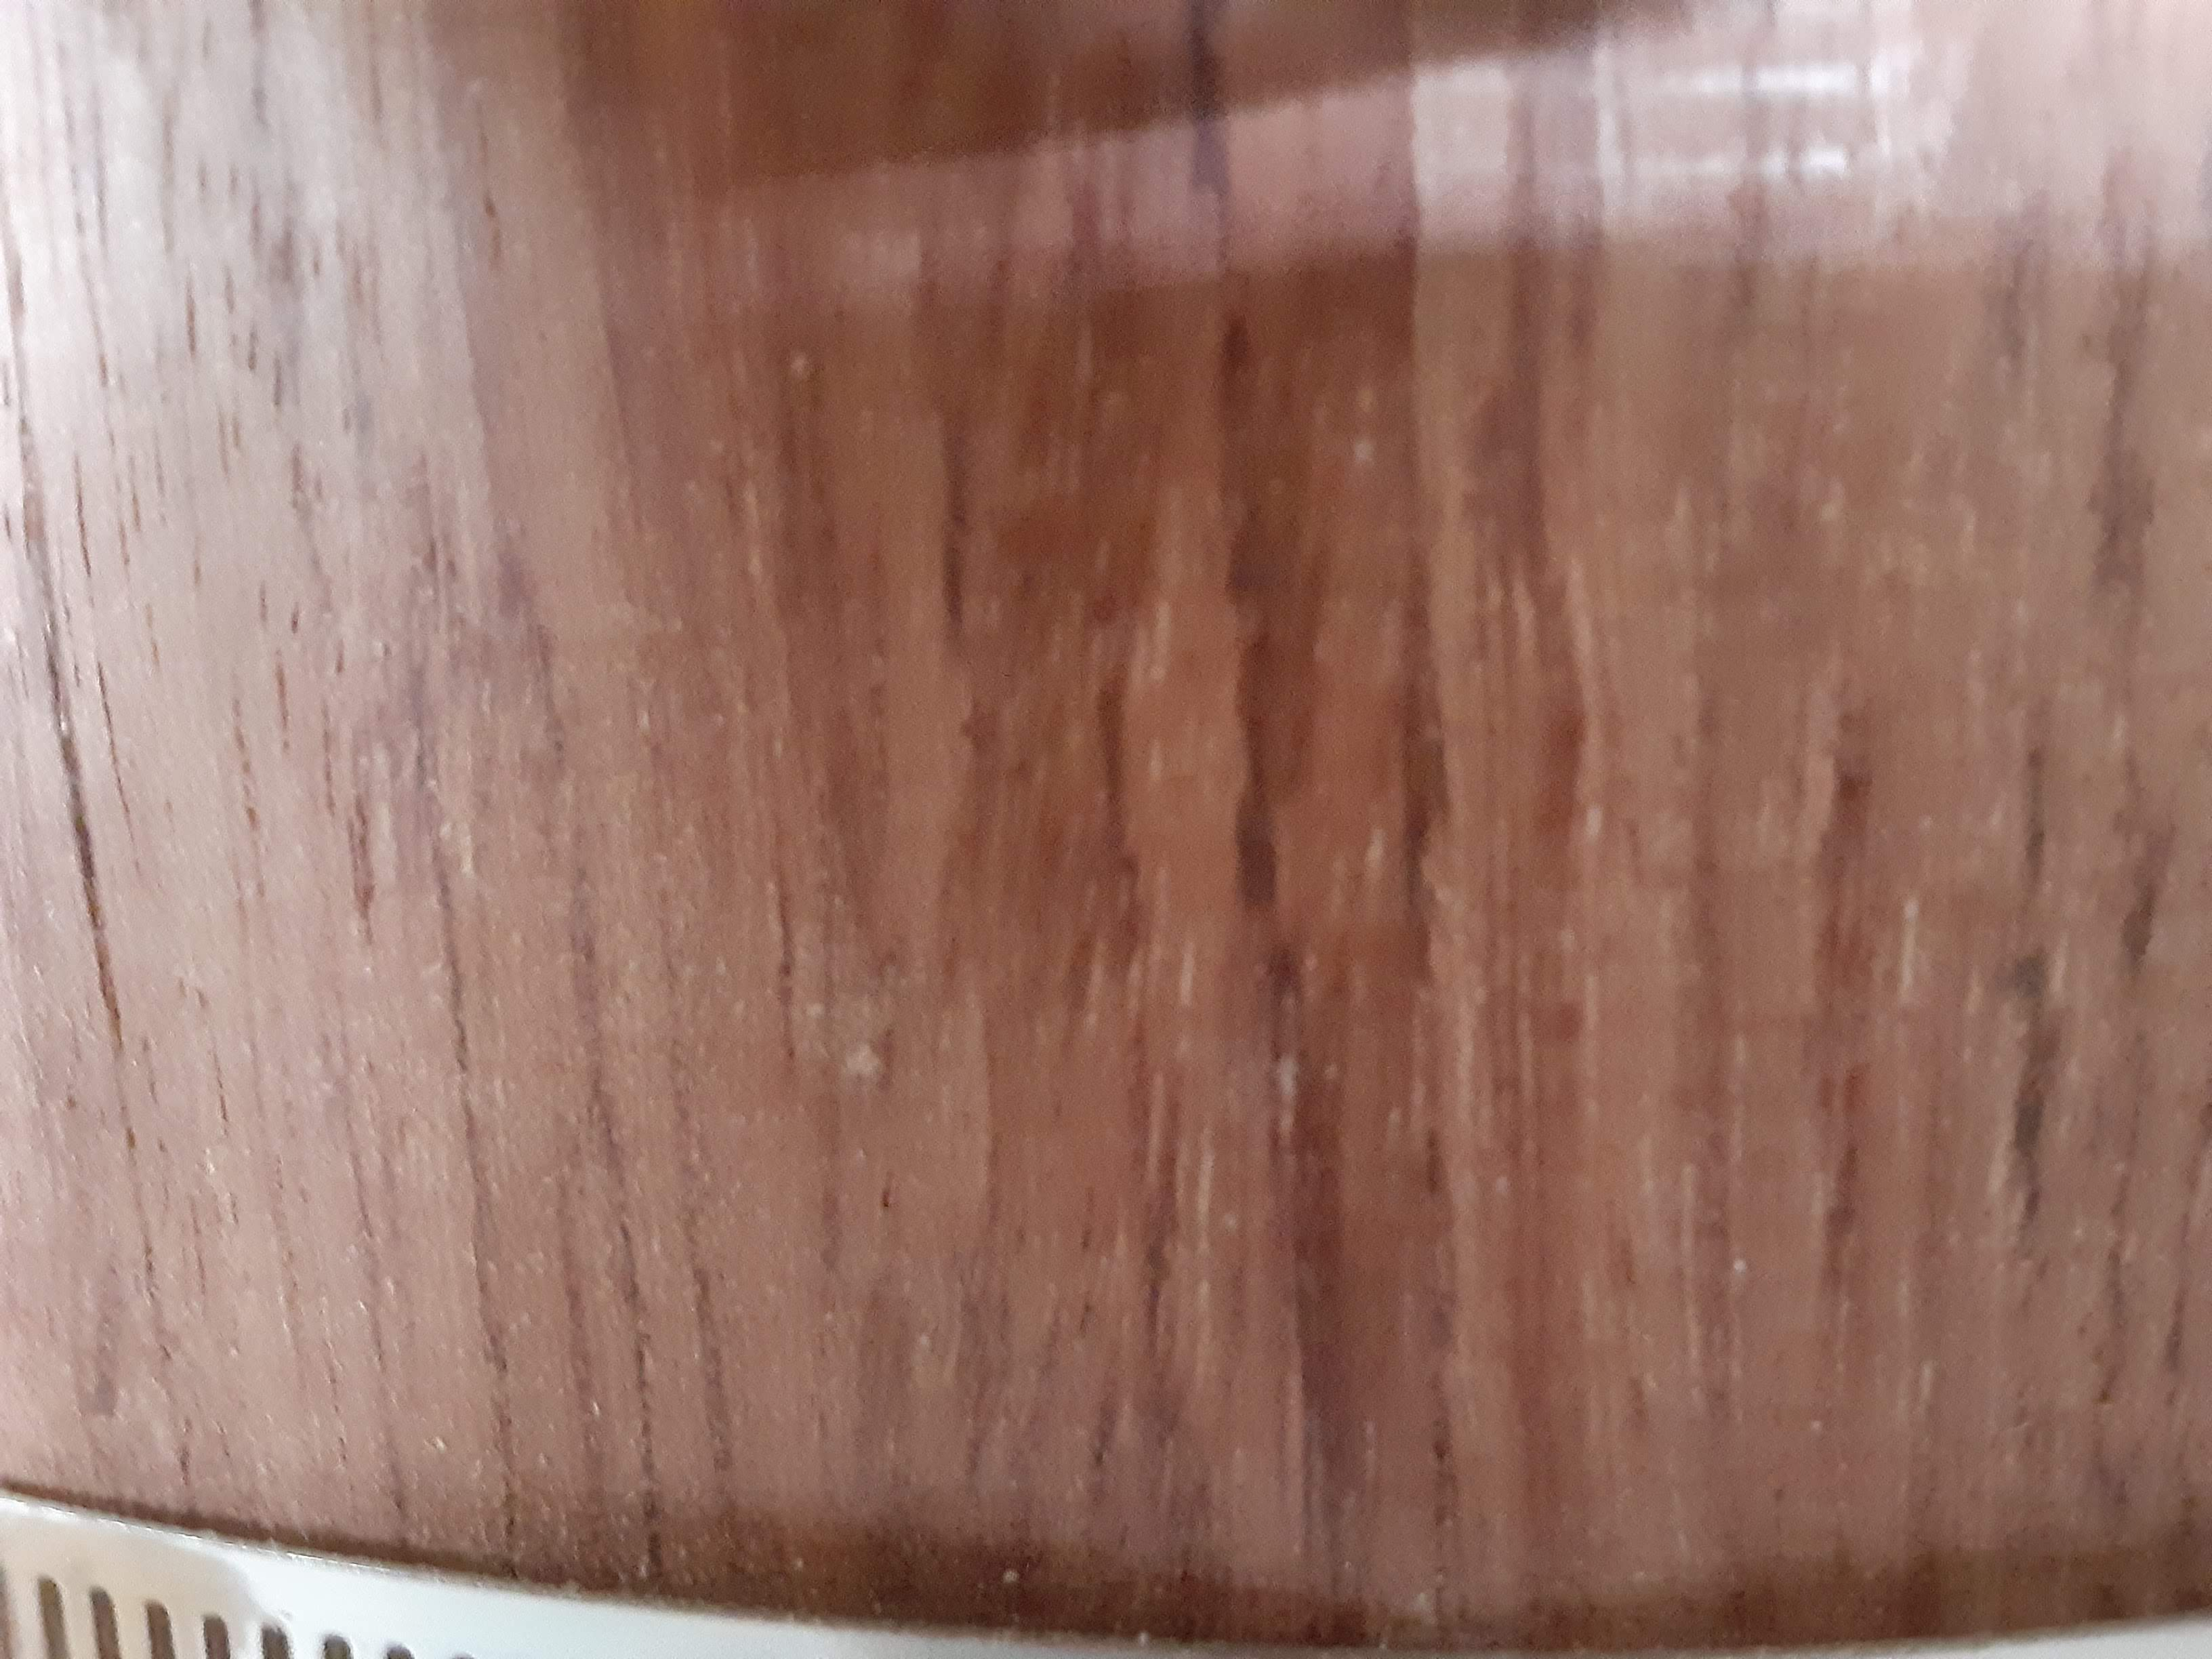

Slide 7
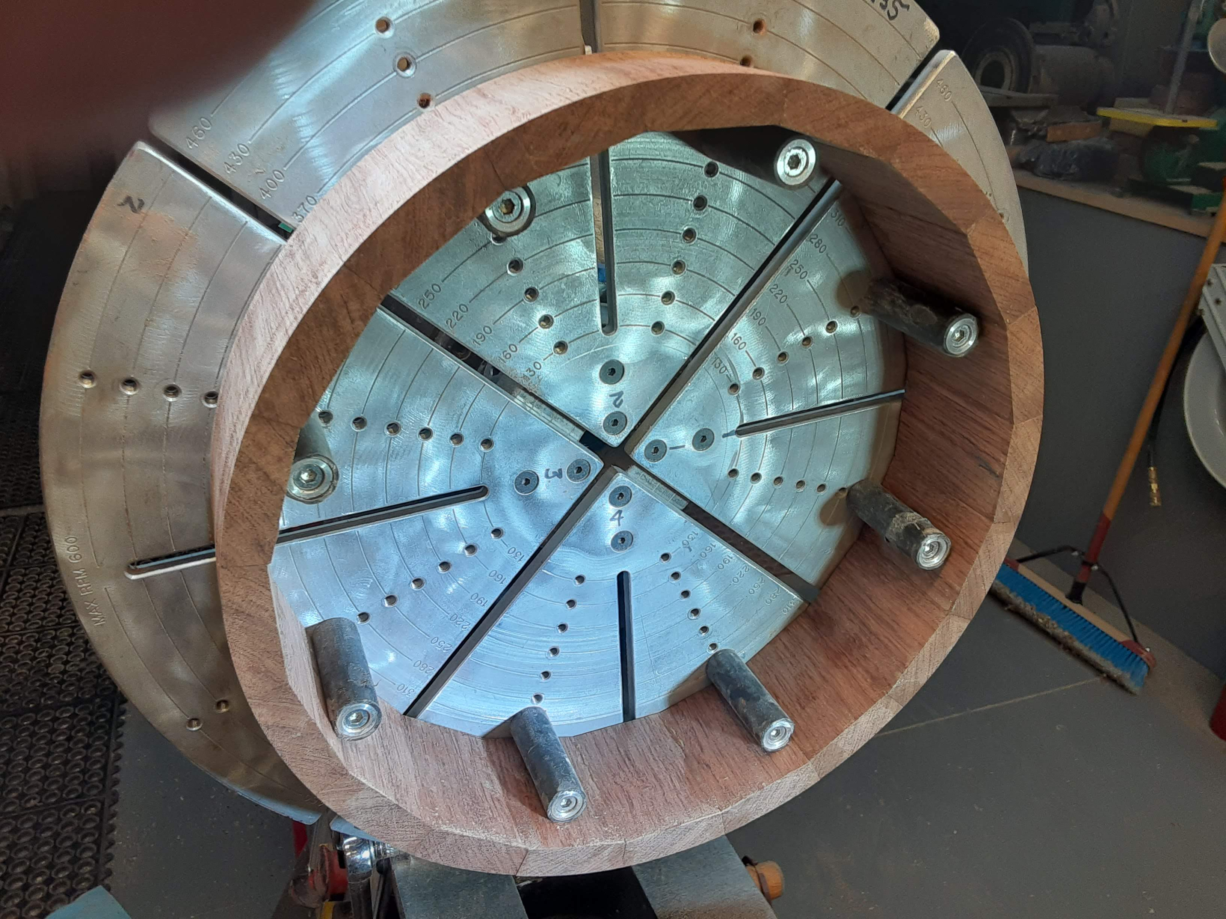

Slide 8
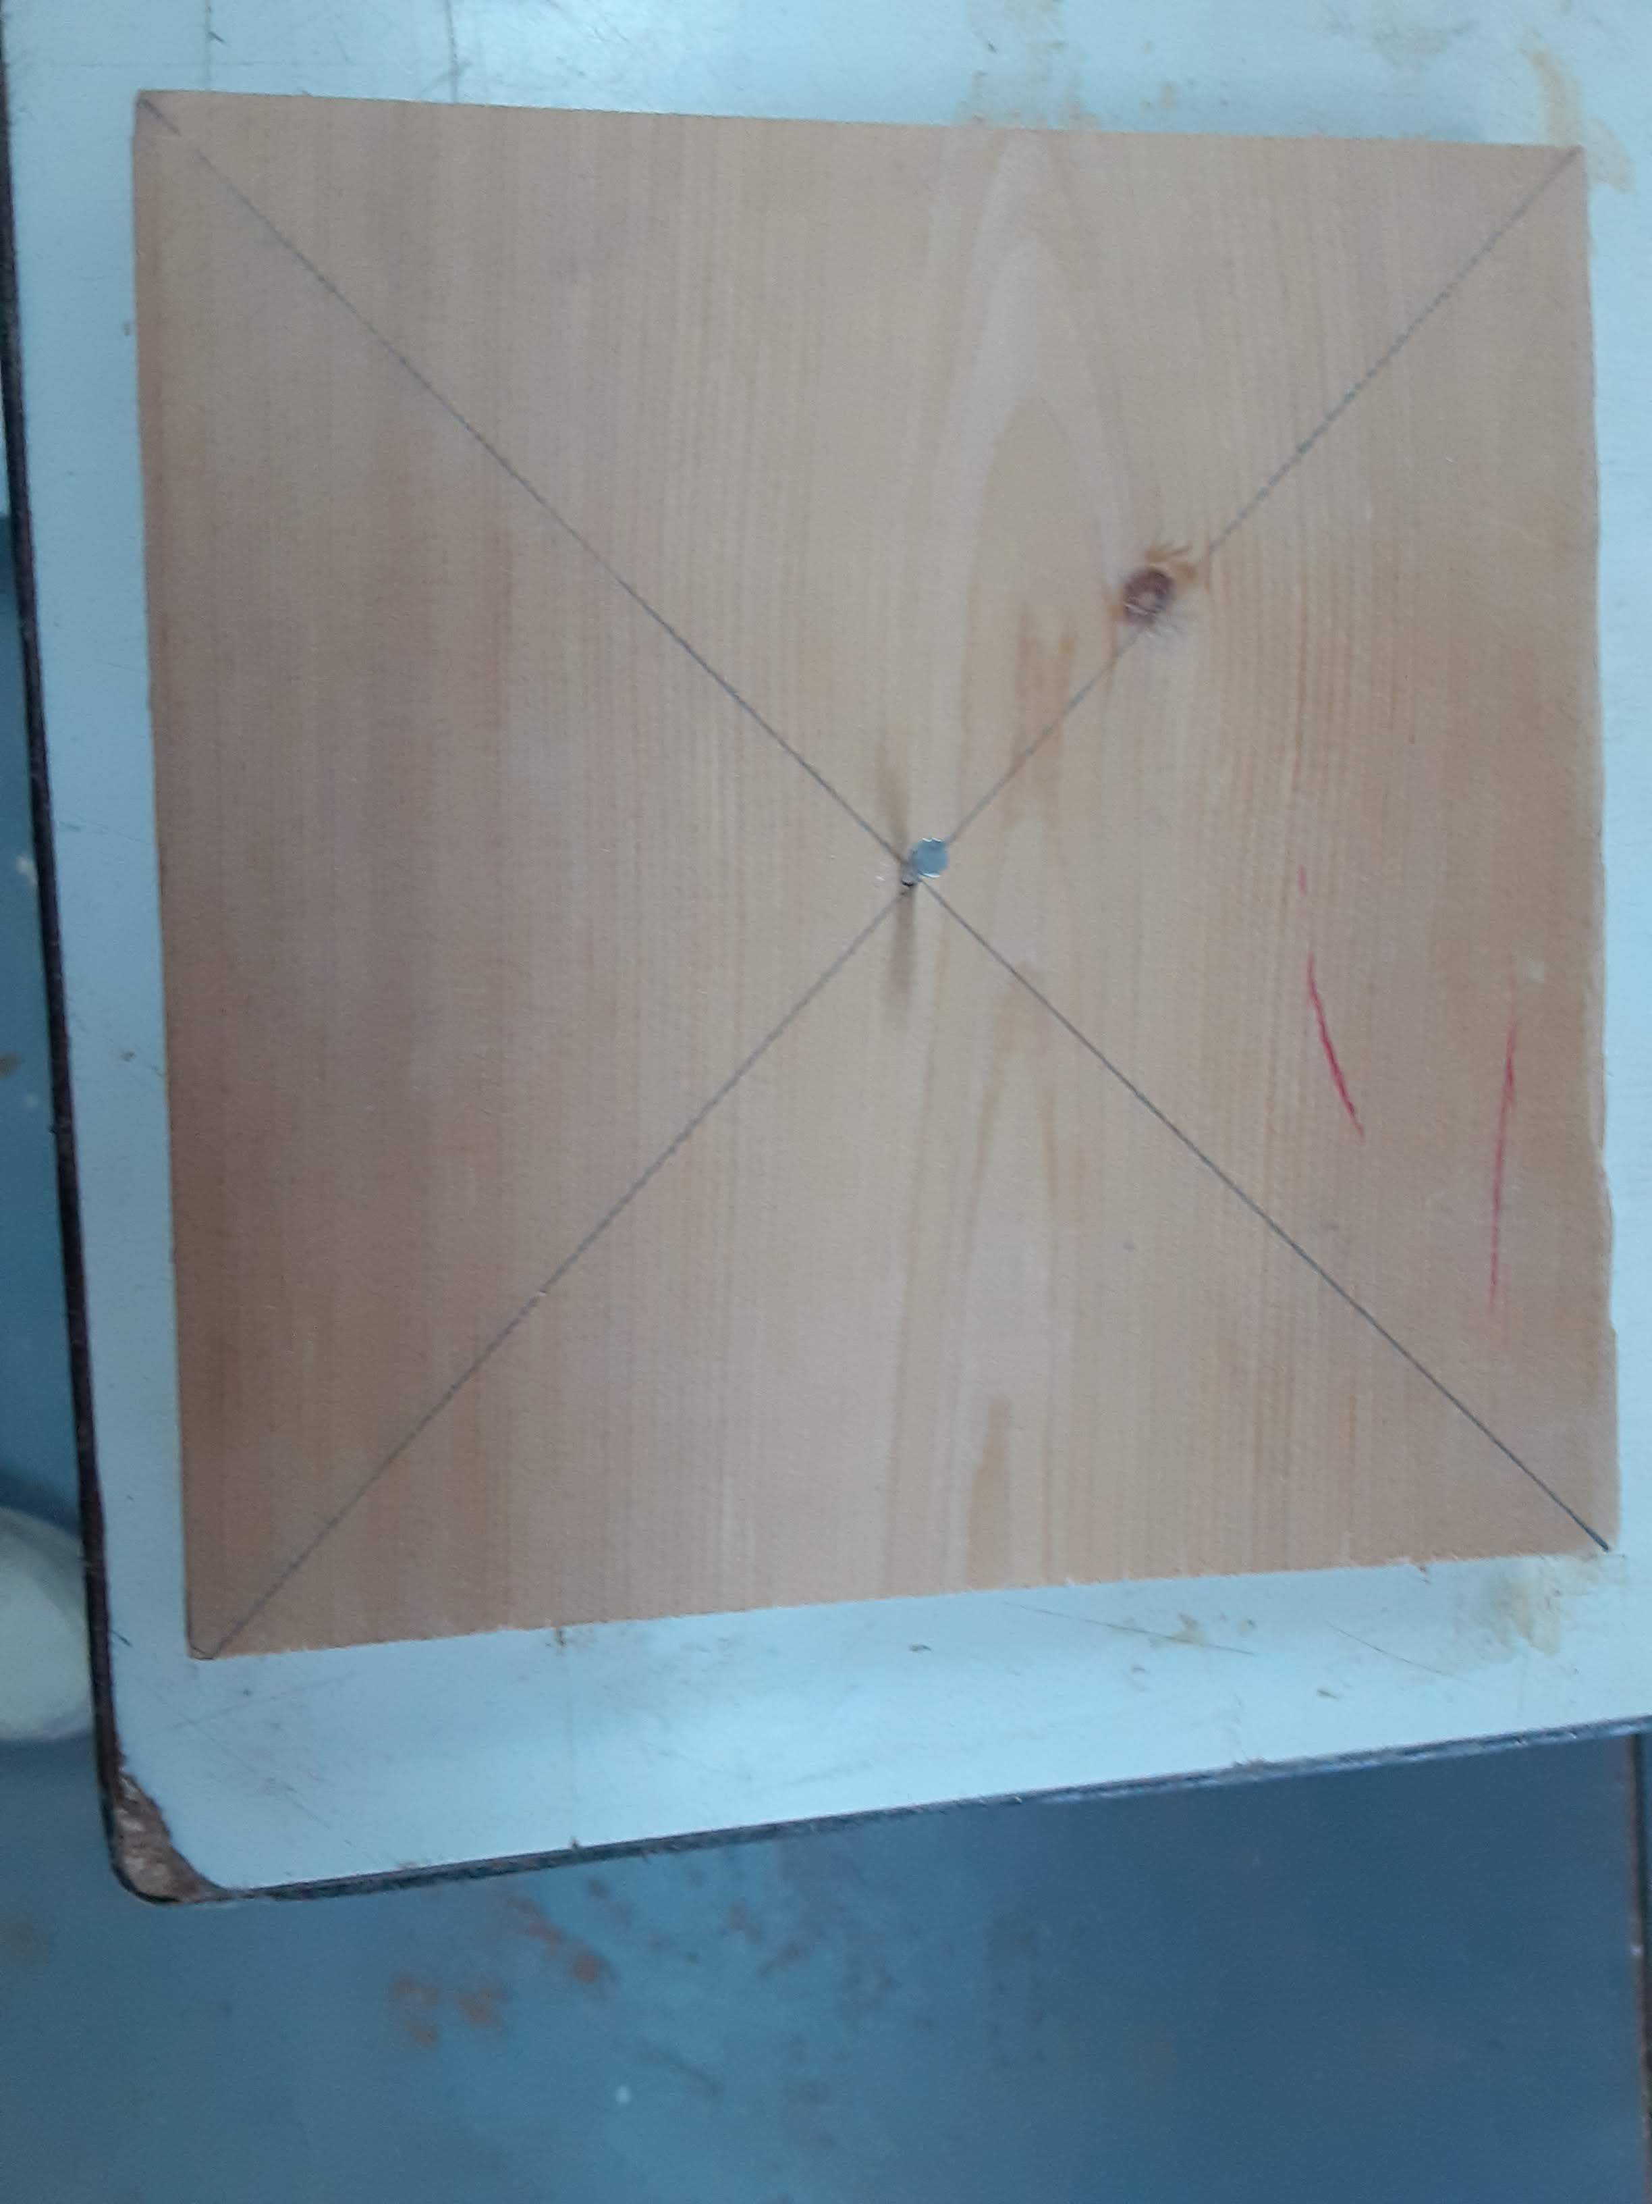

Slide 9
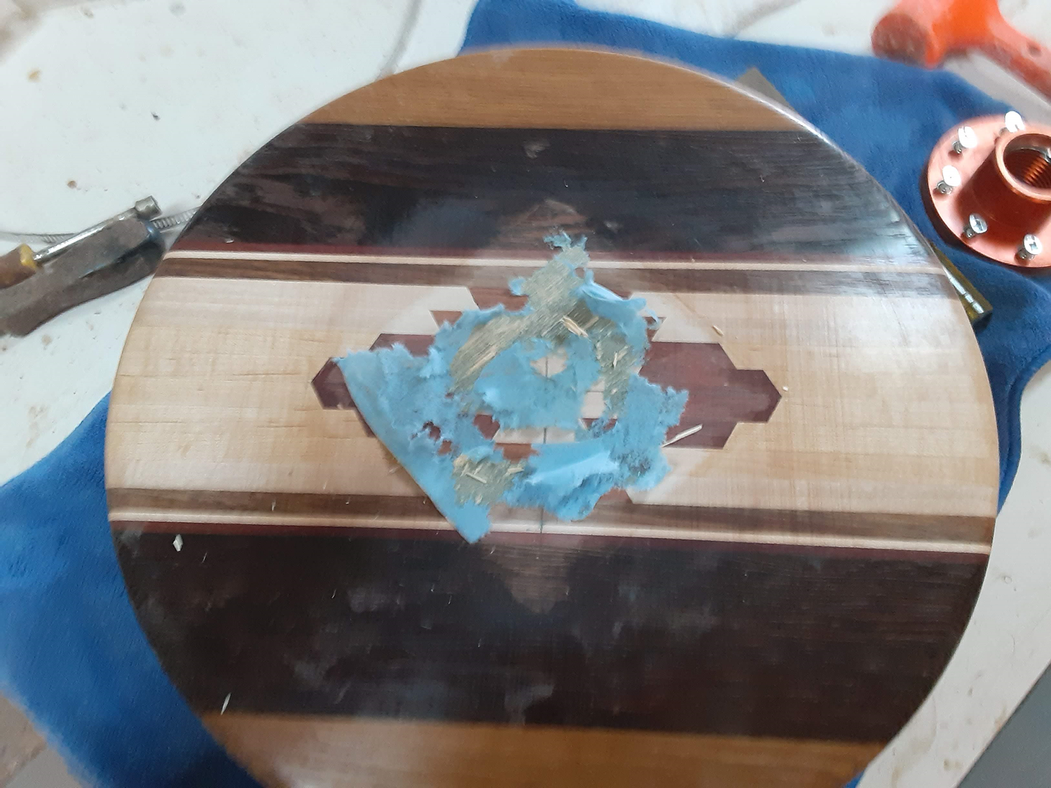

Slide 10
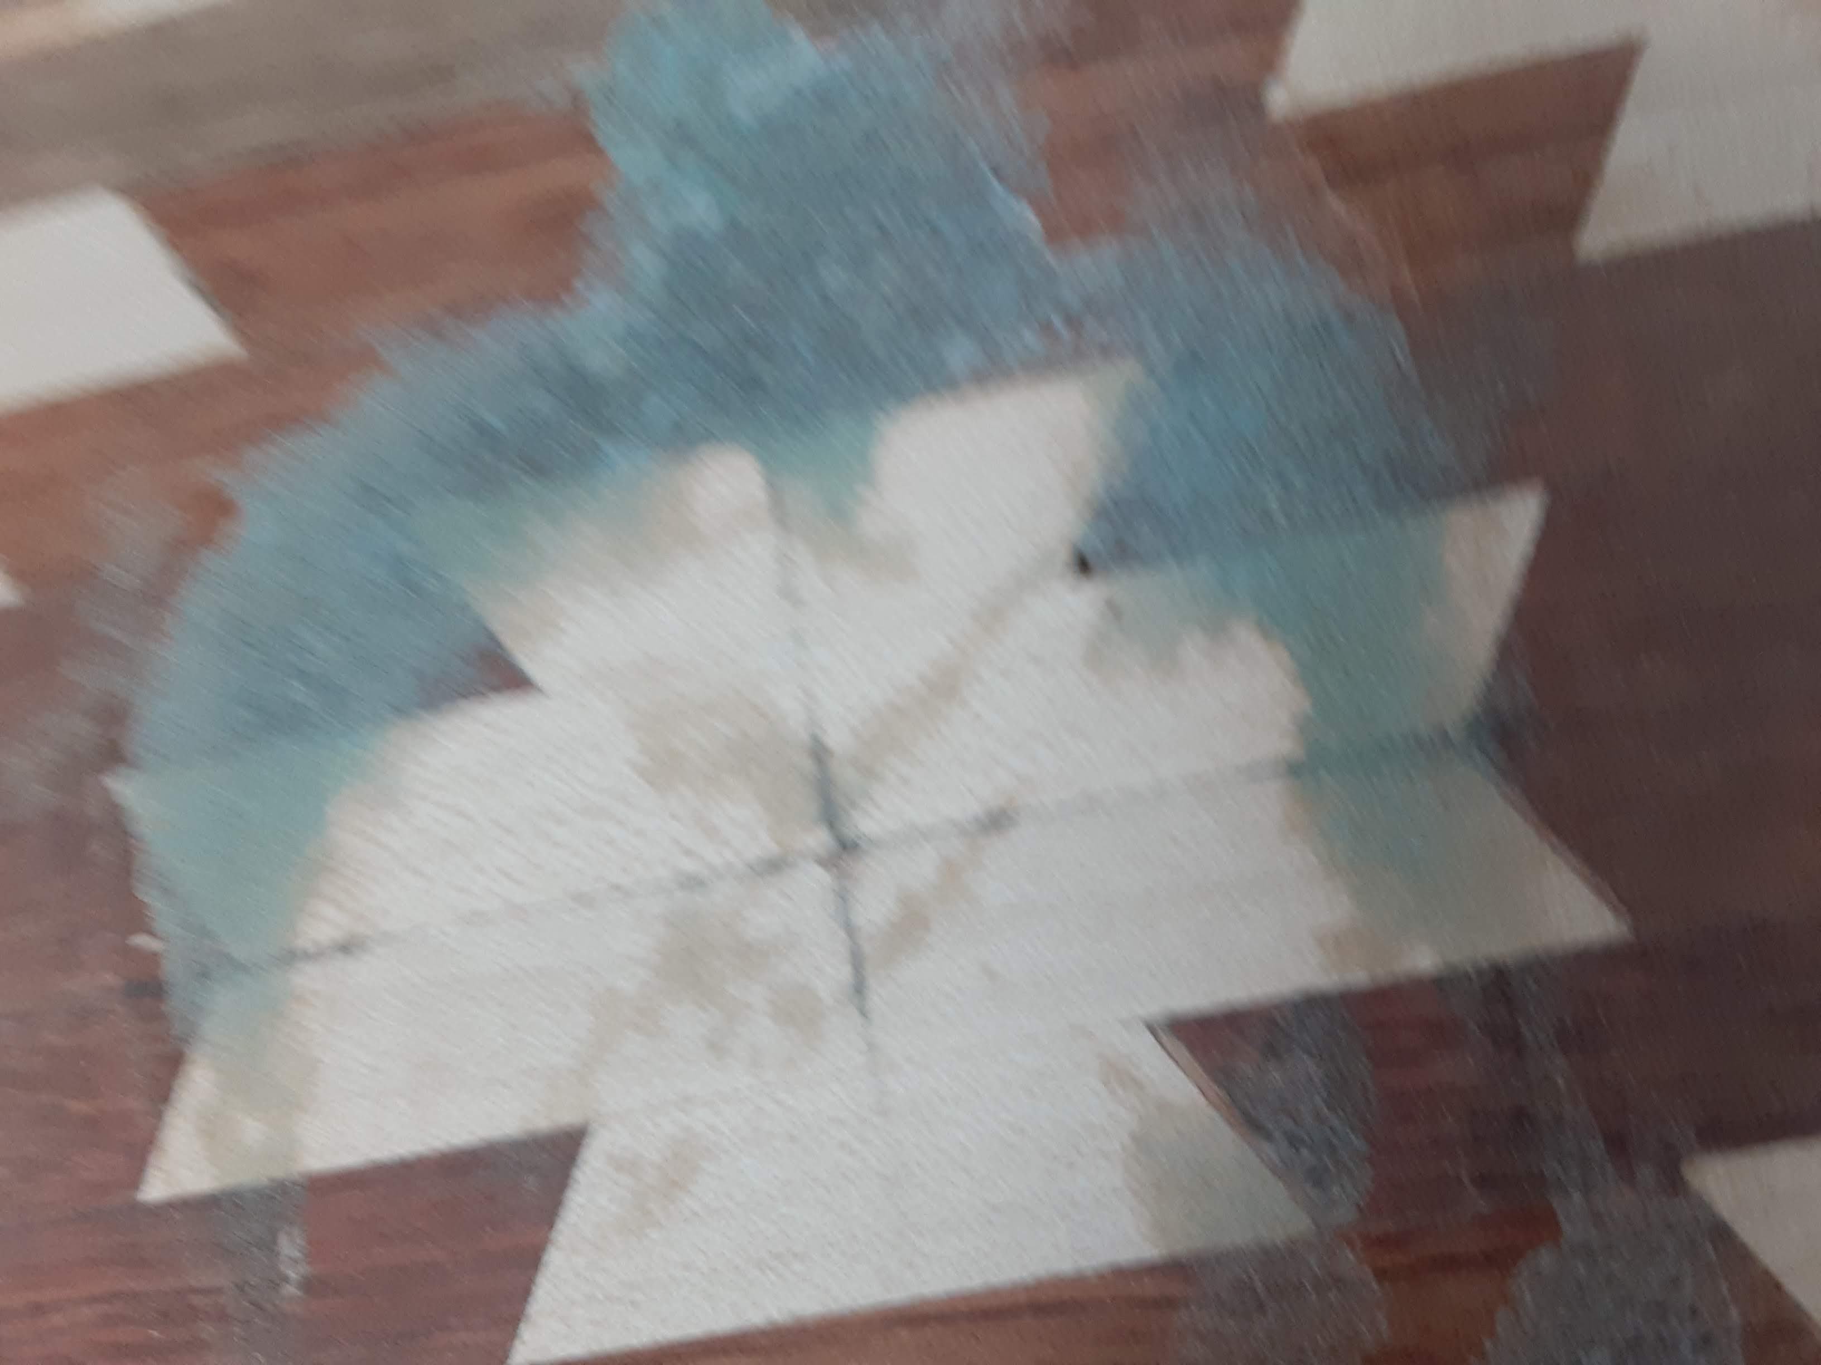

Slide 11
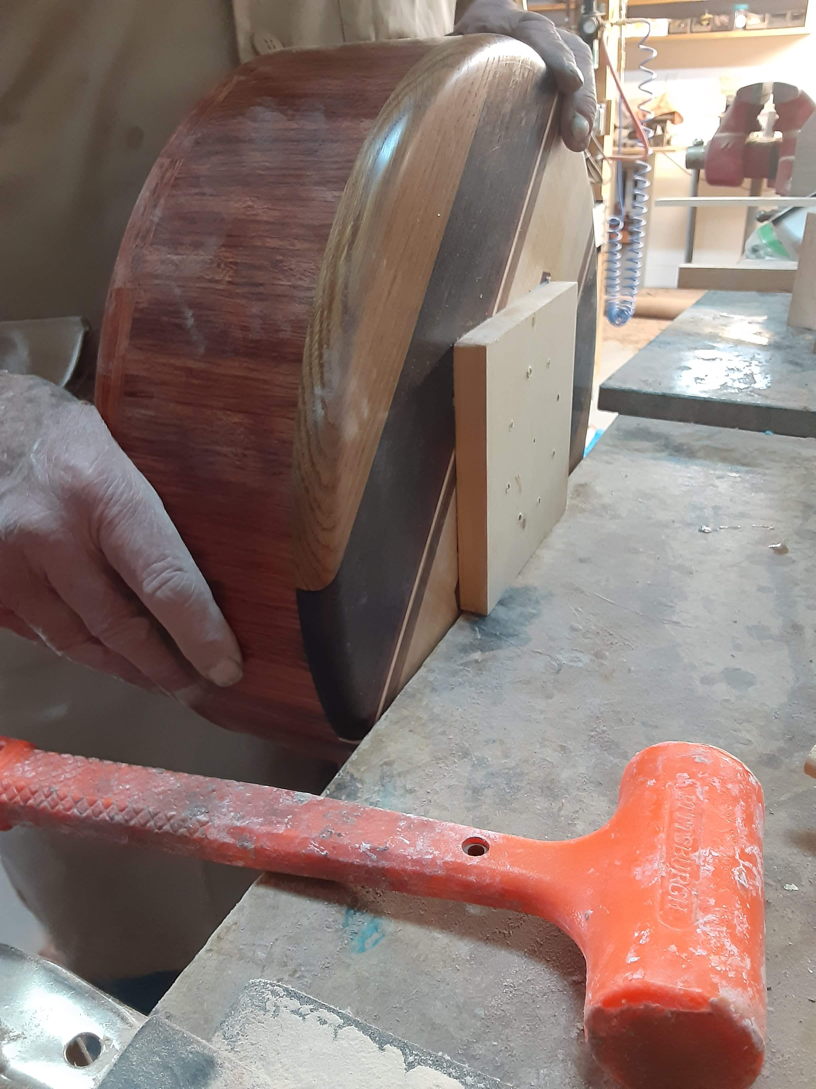

Slide 12
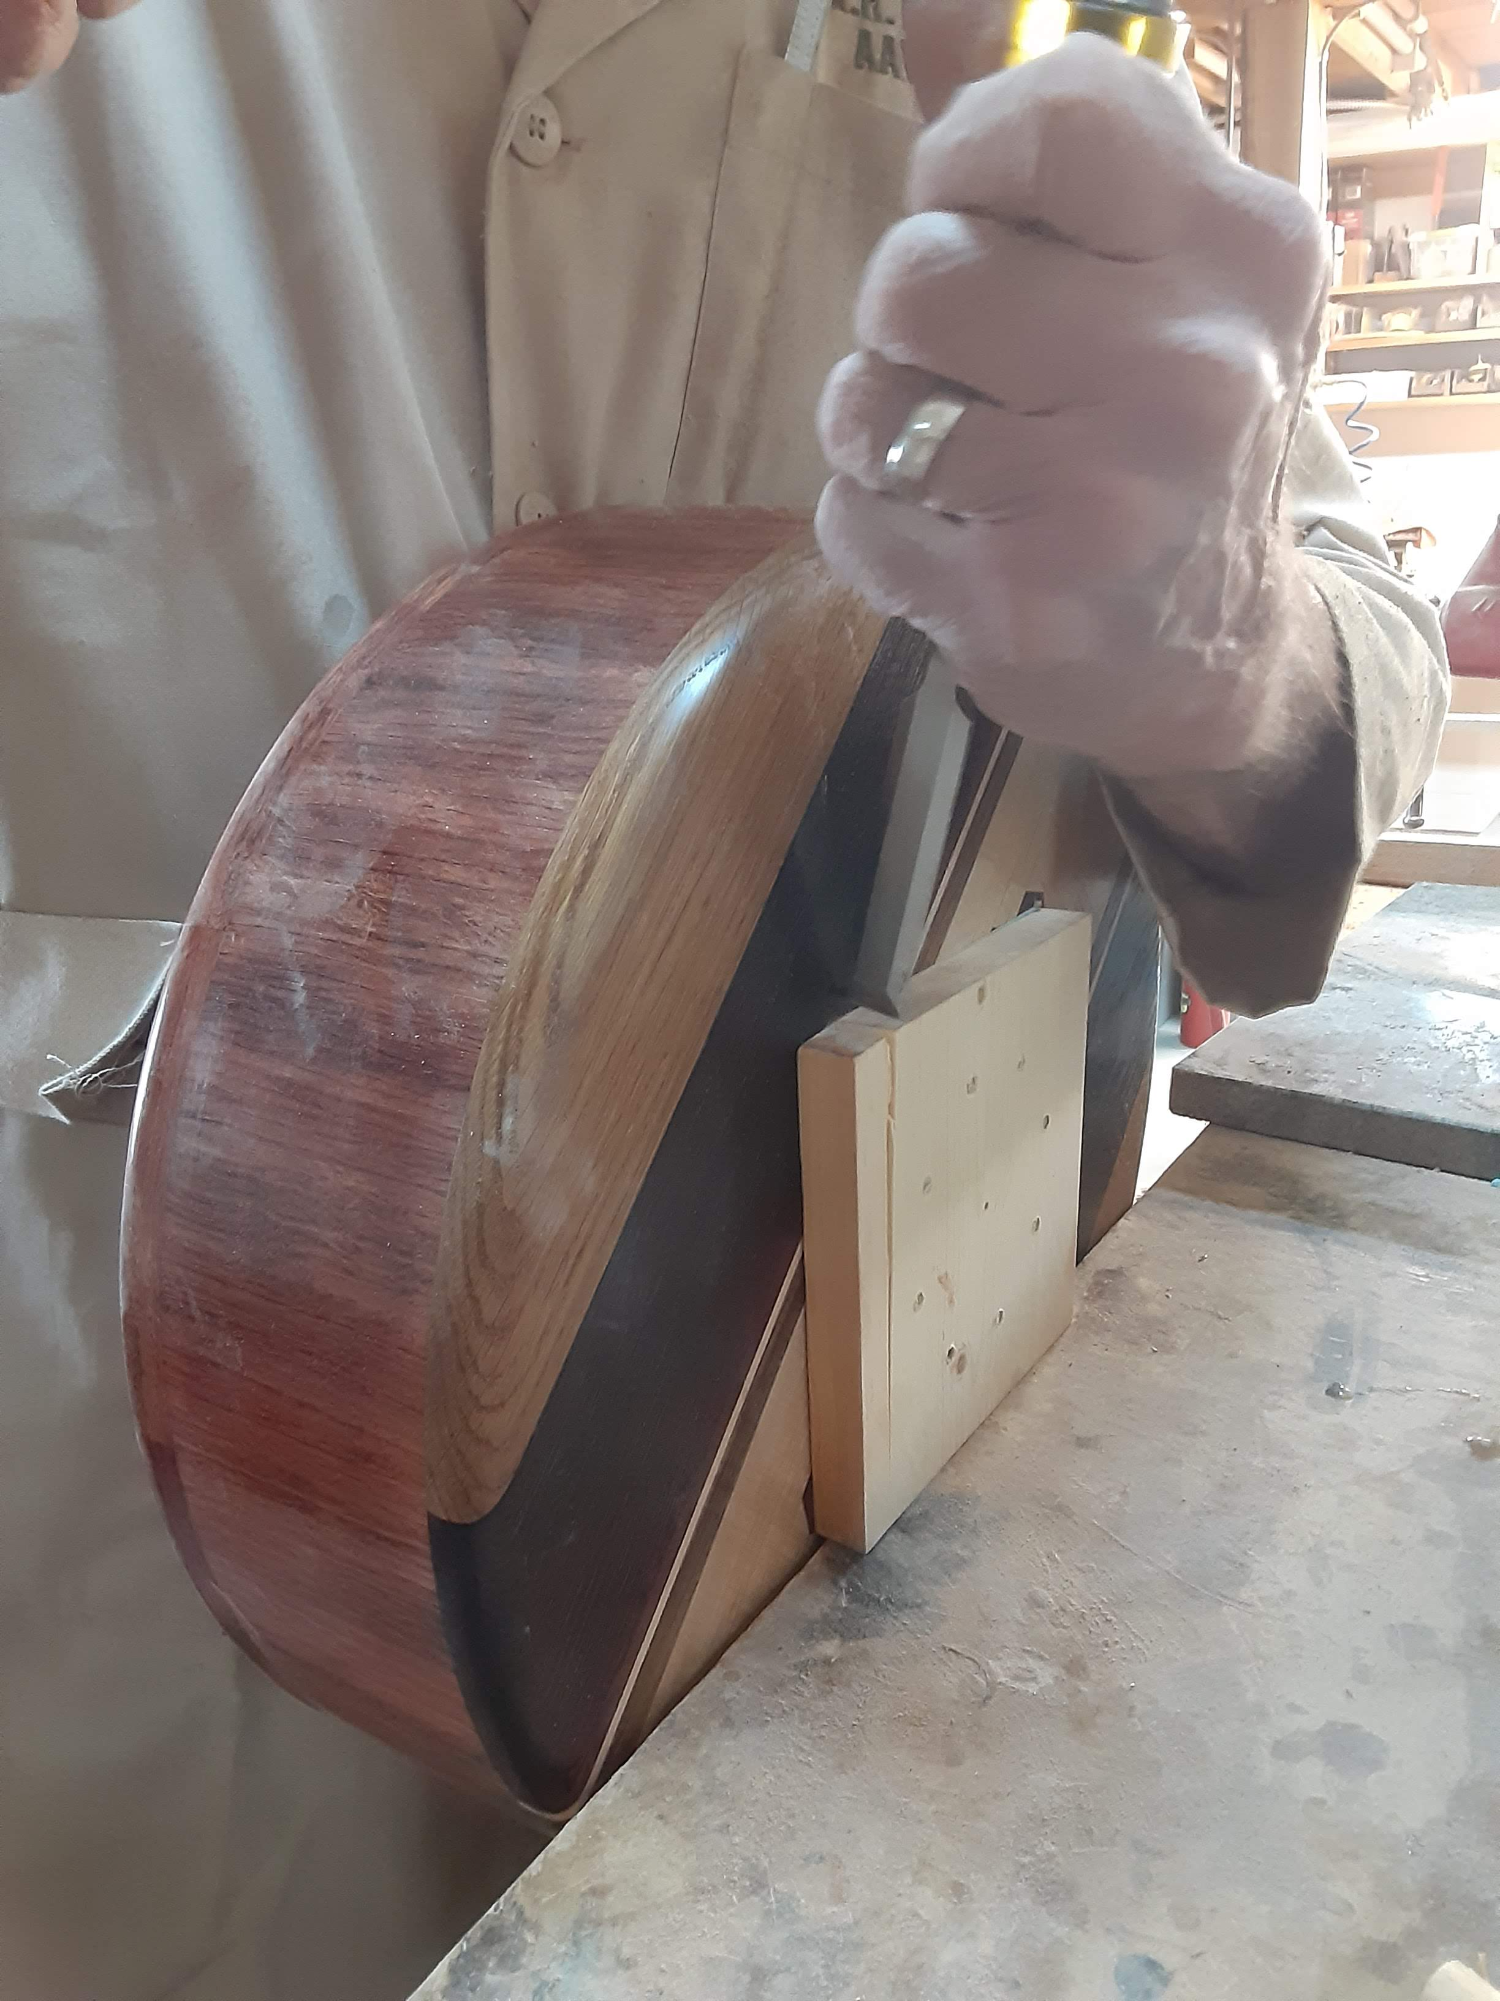

Slide 13
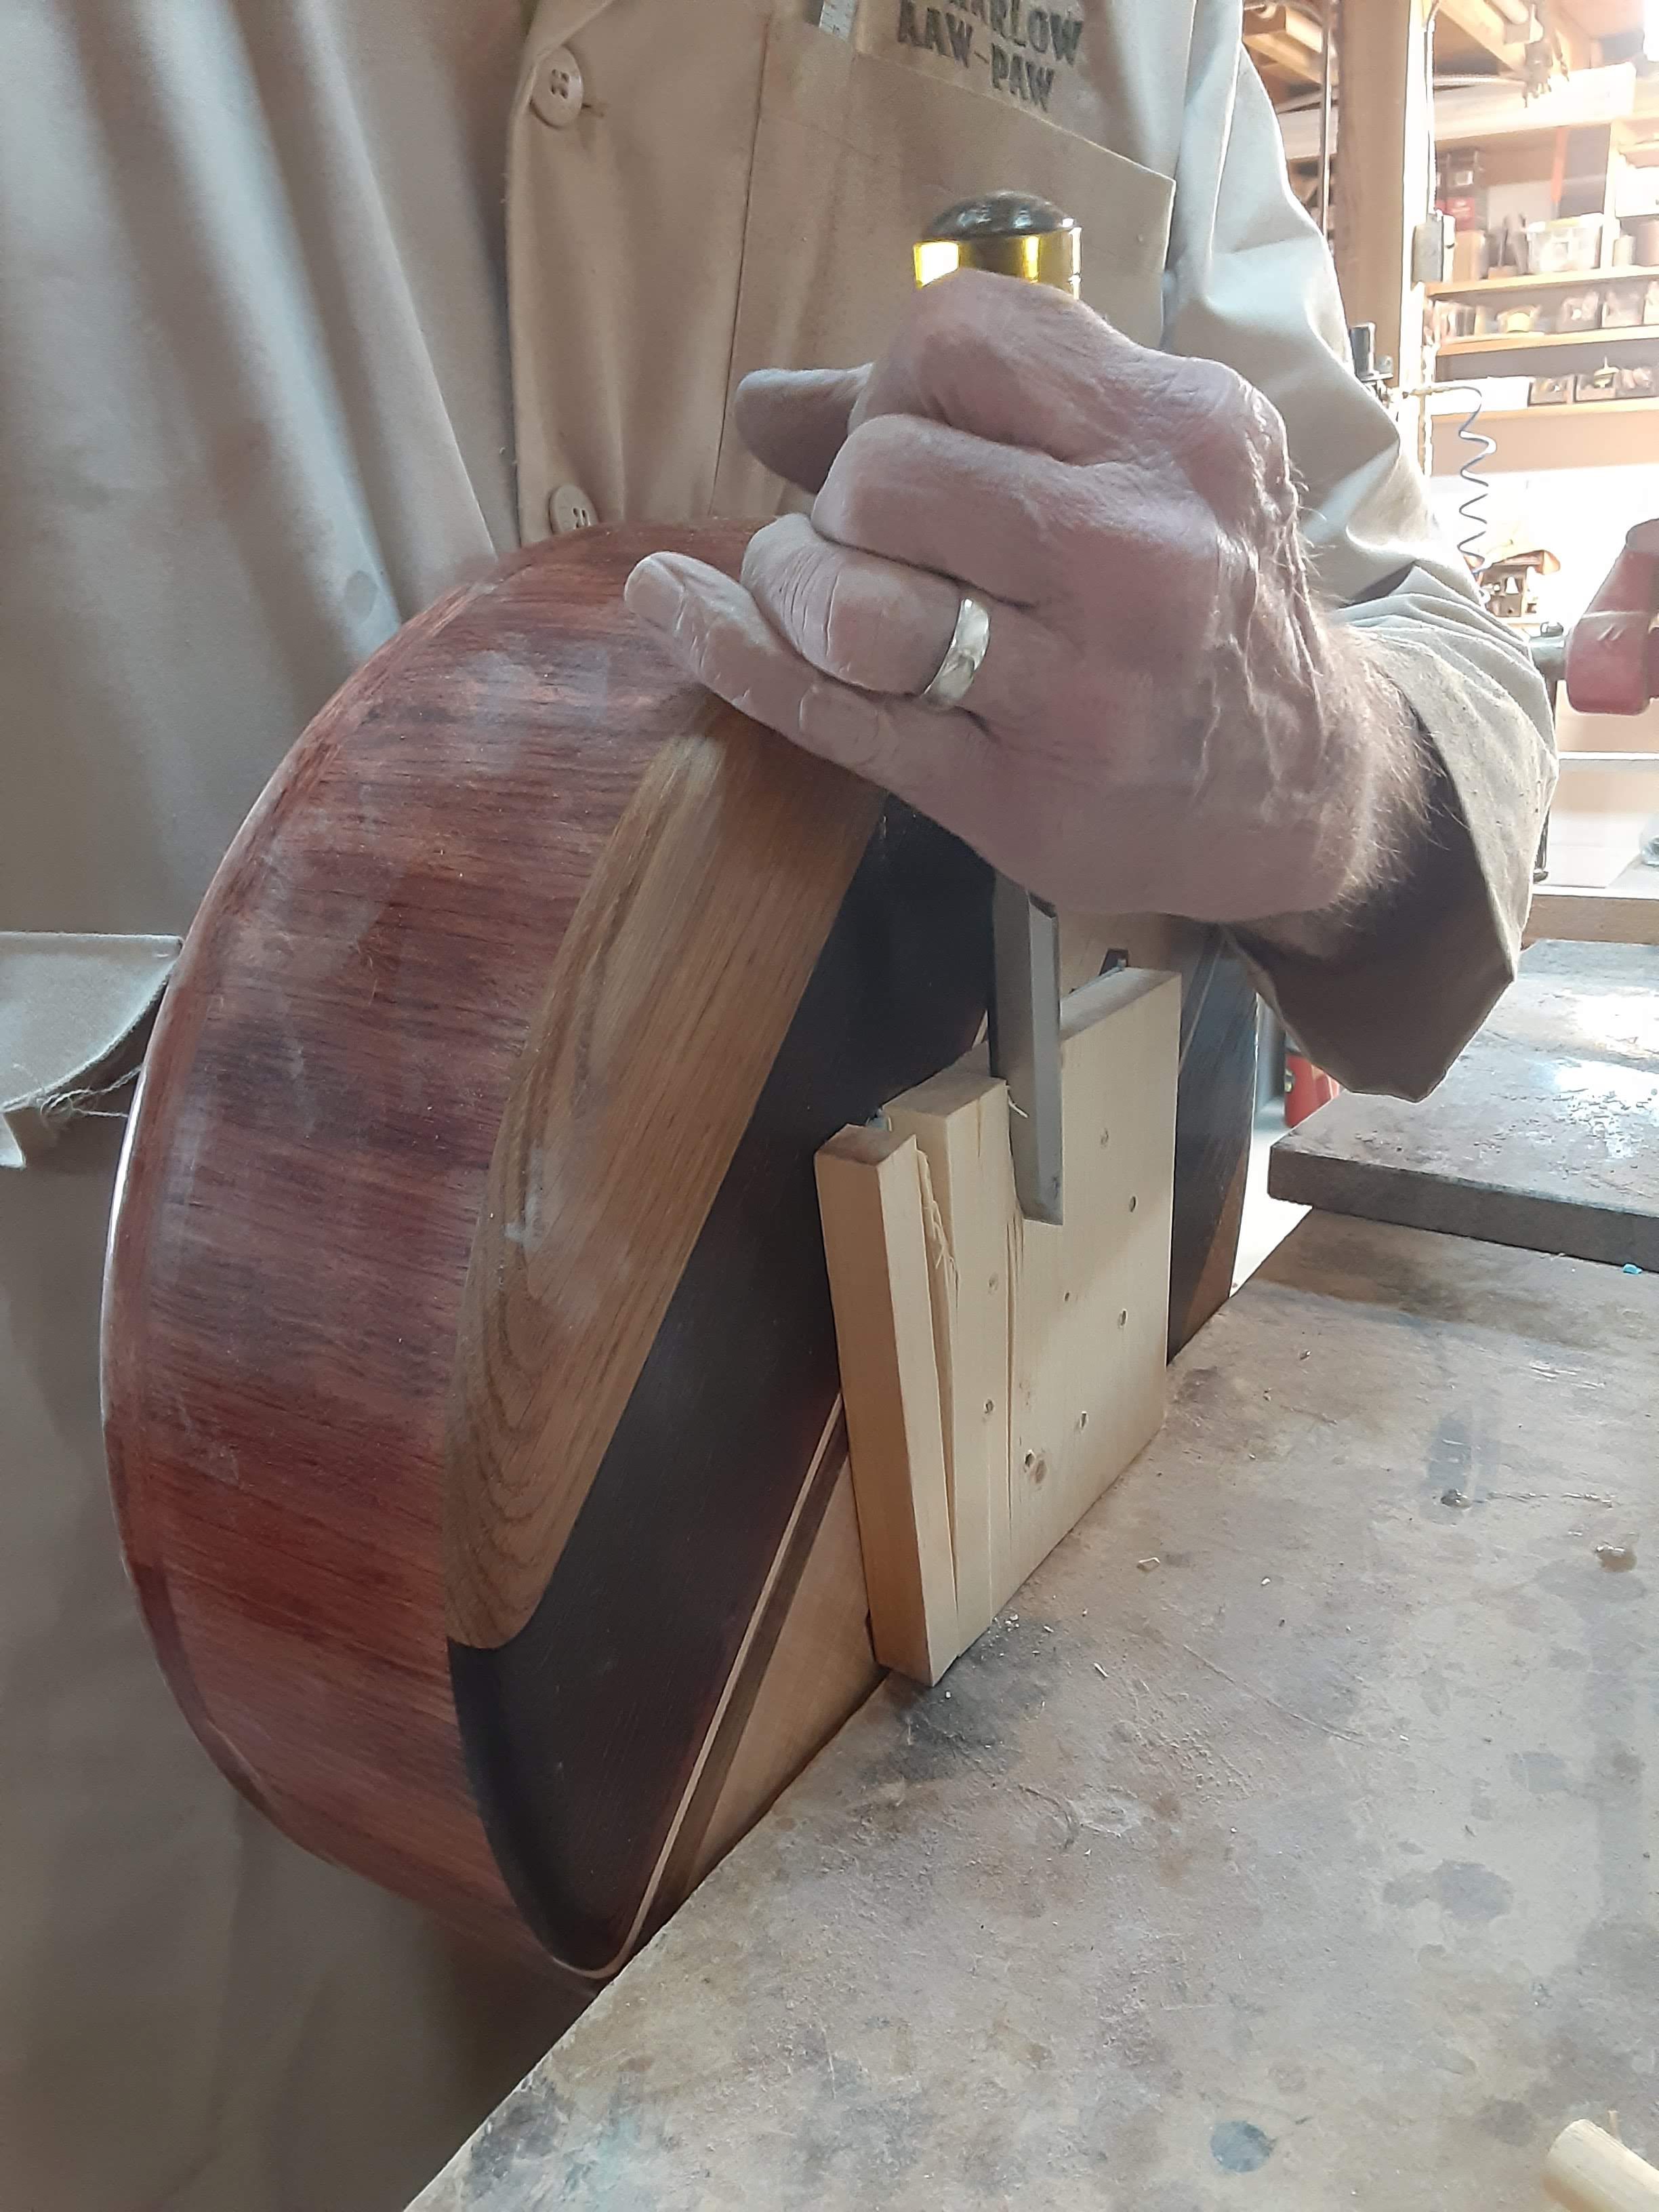

Slide 14
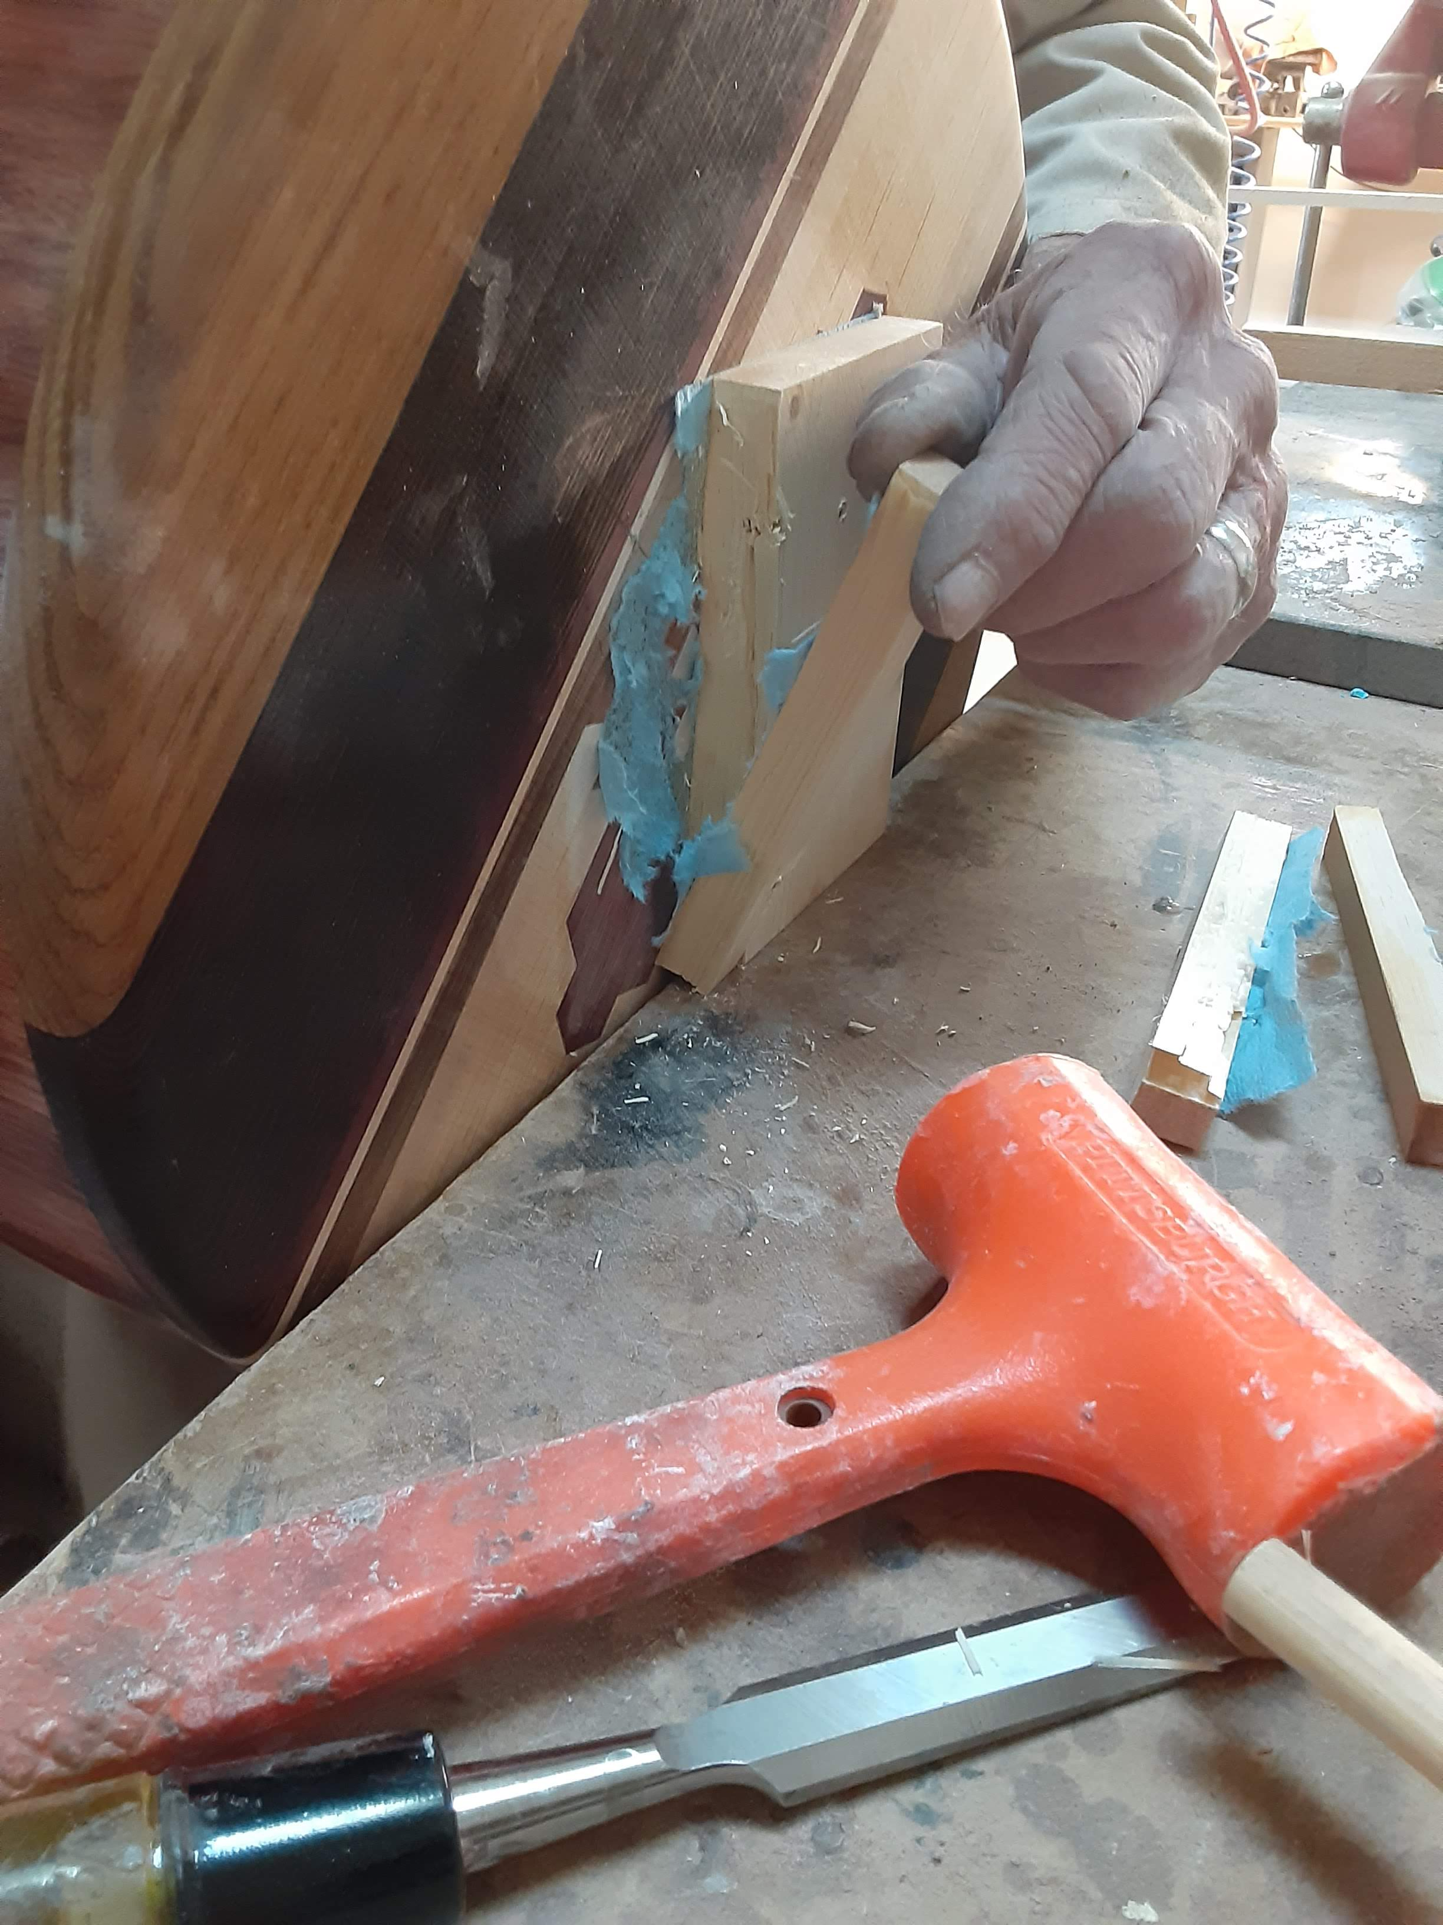

Slide 16
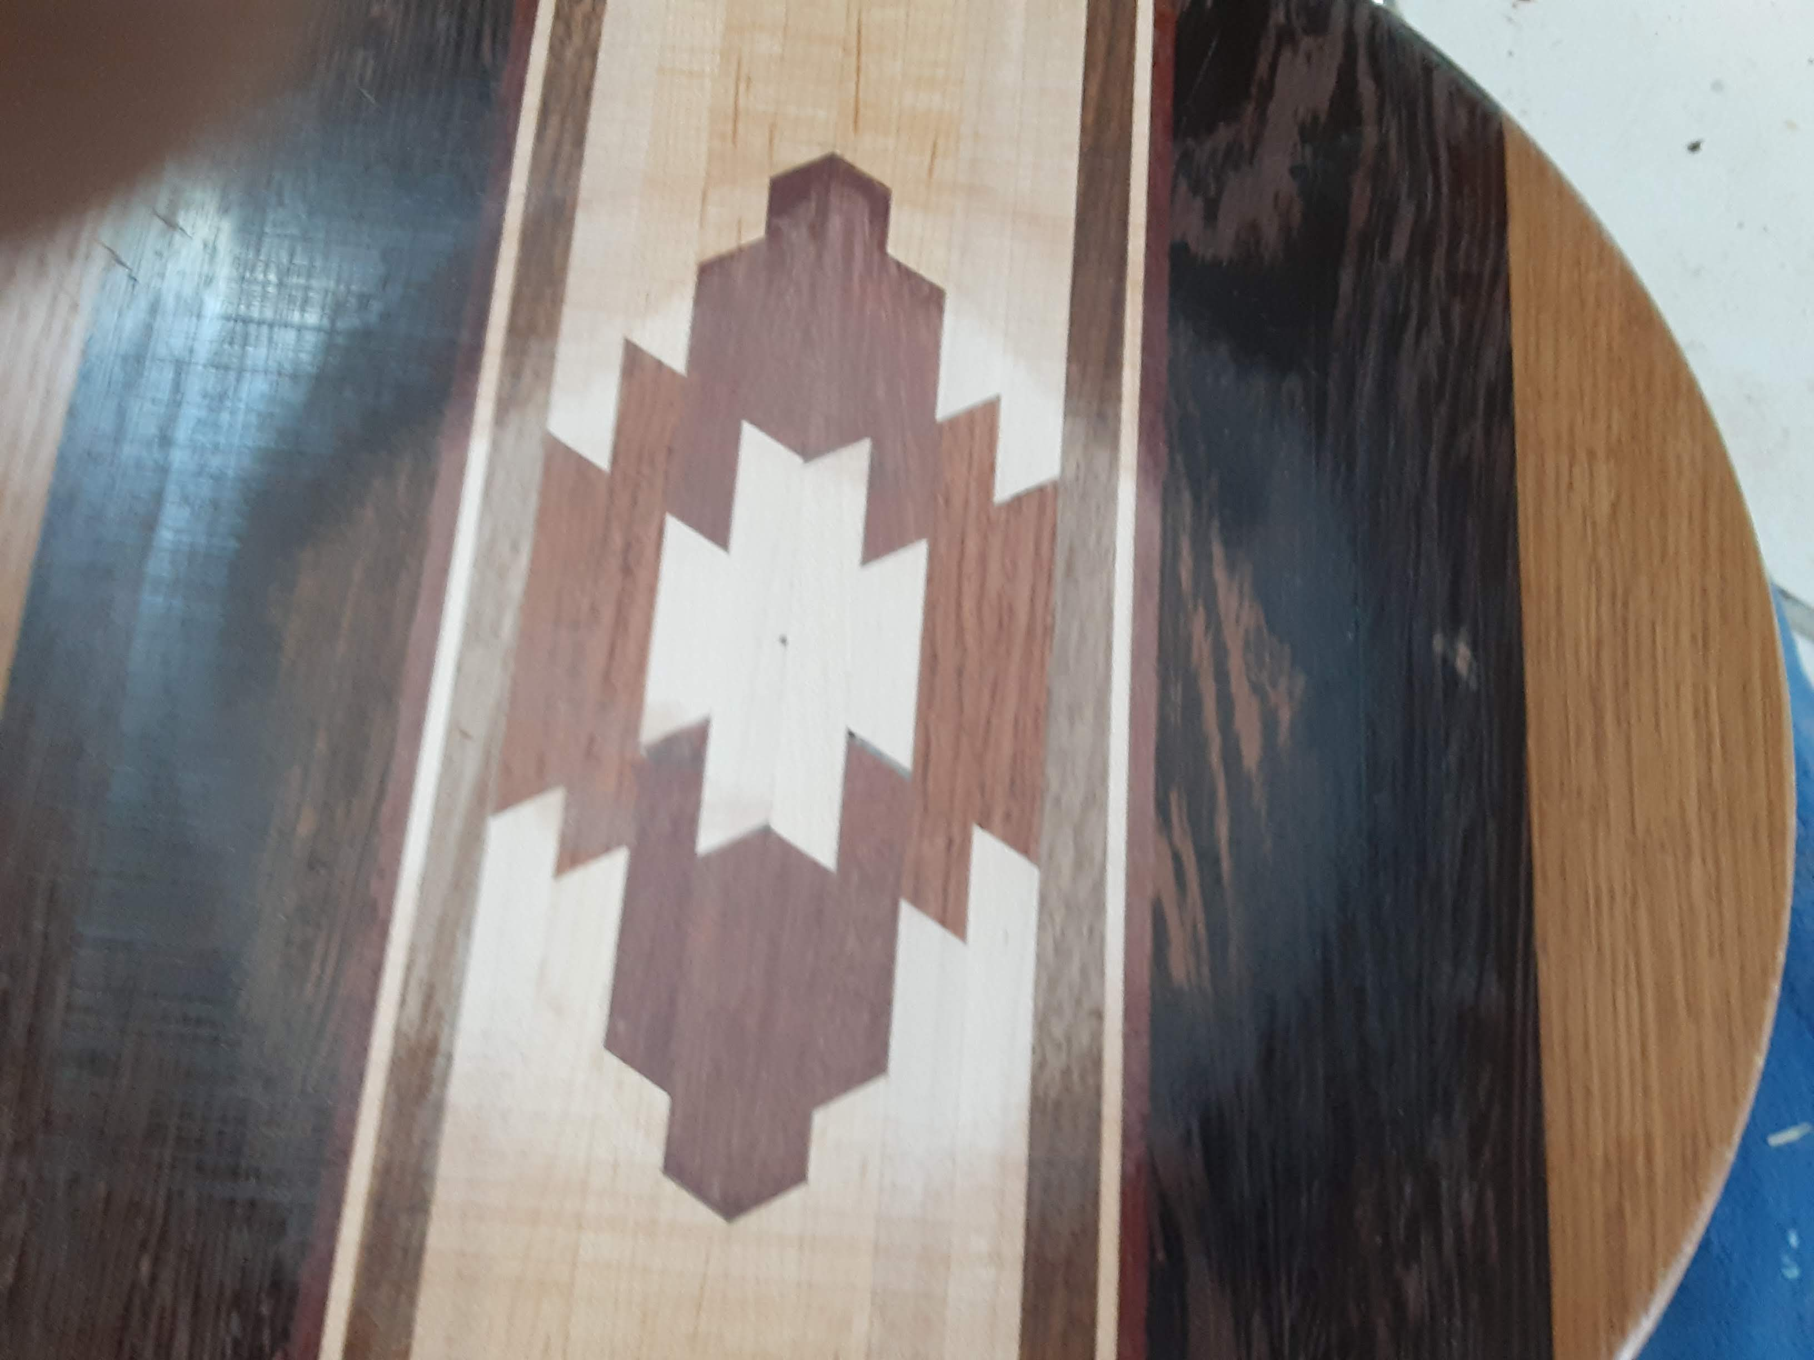

Slide 17
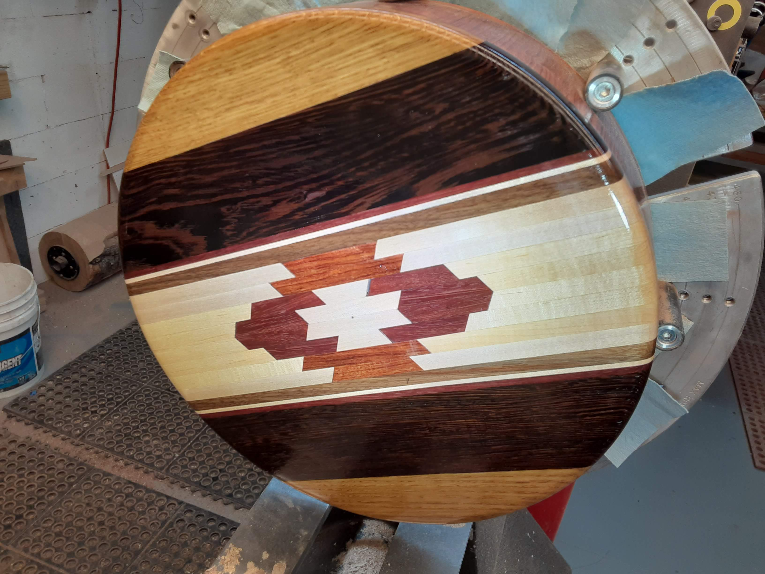

Slide 18
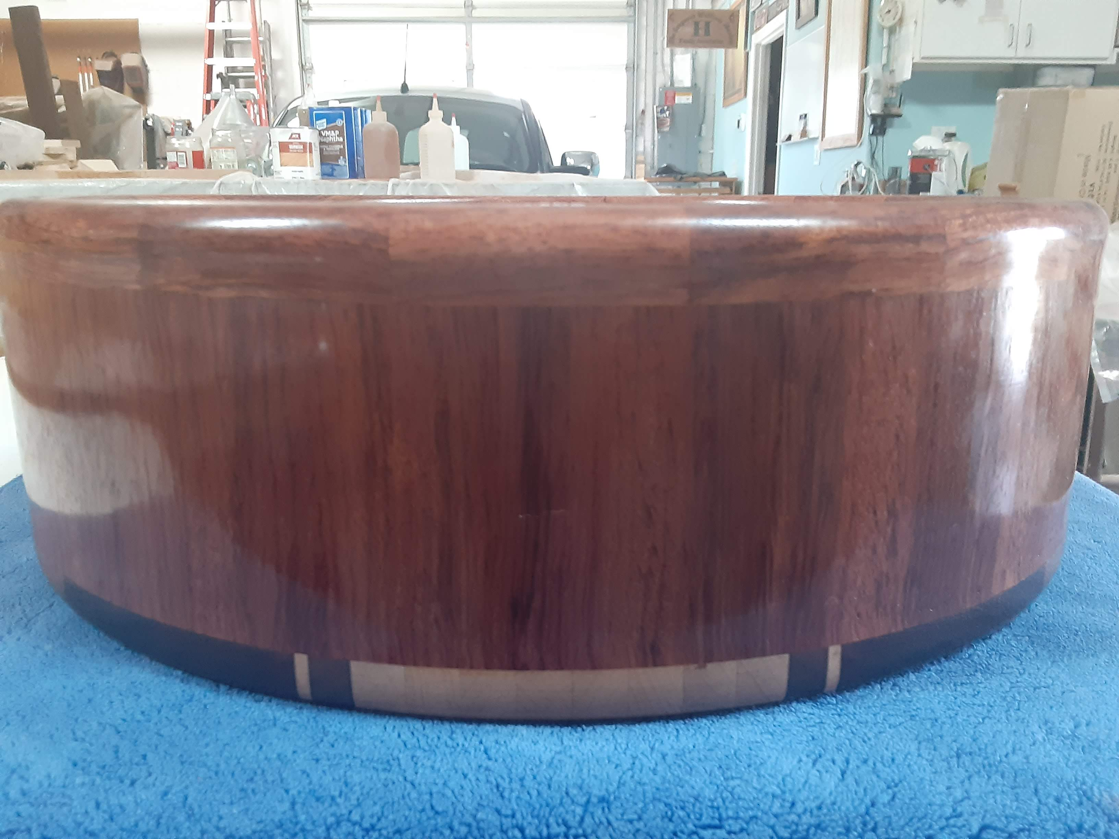

Slide 19
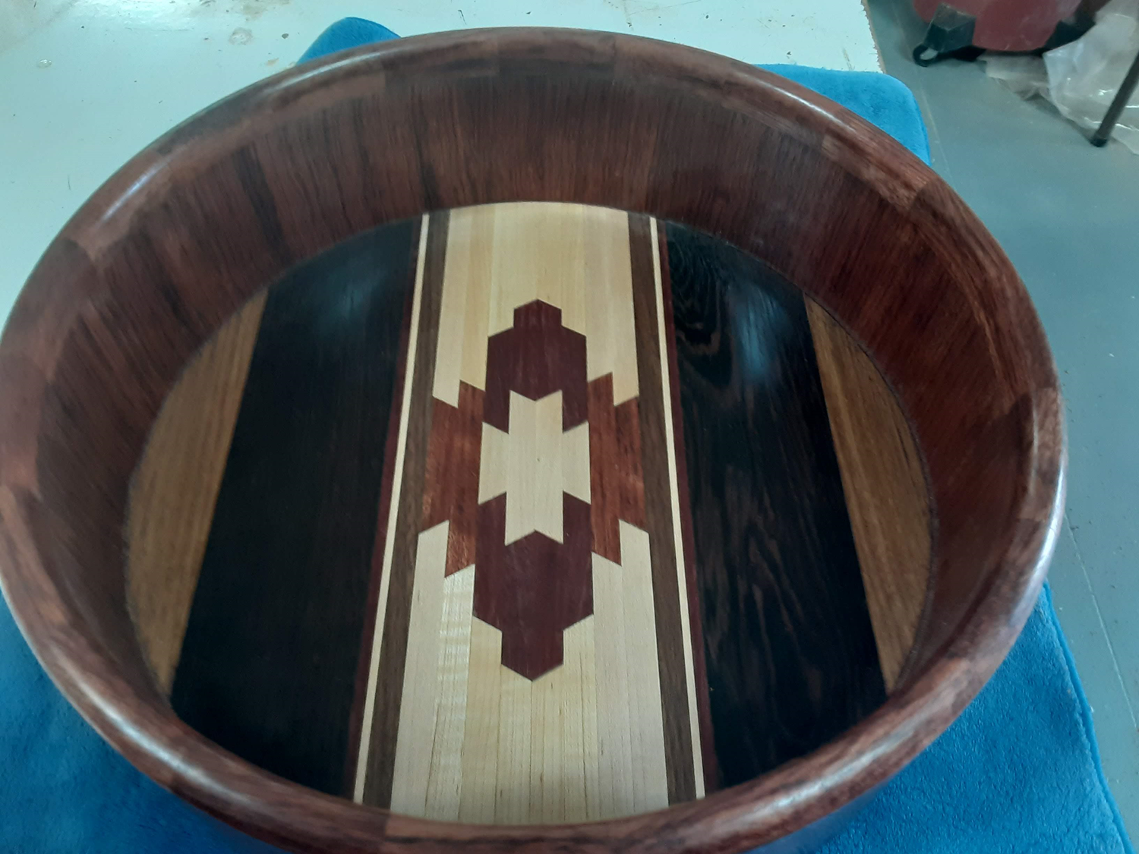

Slide 20
